Slide 1
Operating Systems
Course #11 OS Security
Răzvan Daniel ZOTA
Faculty of Cybernetics, Statistics and Economic Informatics
zota@ase.ro
https://zota.ase.ro/os

Slide 2
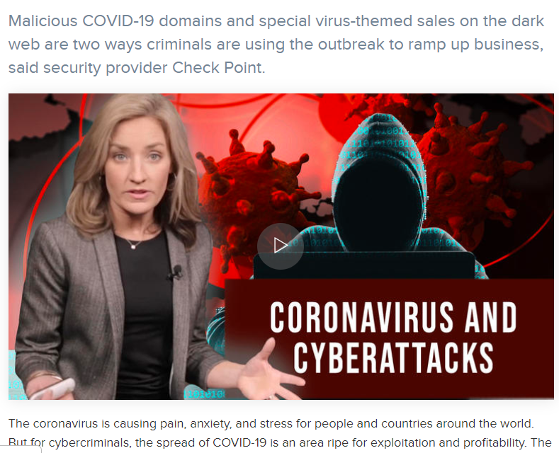
Today’s cybercrimes

Slide 3
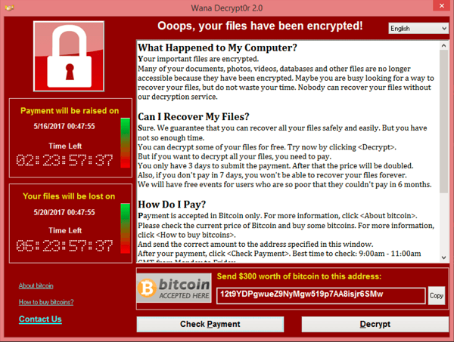
Cybercrimes from the (near) past
WannaCry (or WannaCrypt,^{[3]} WanaCrypt0r 2.0,^{[4][5]} Wanna Decryptor^{[6]}) is a ransomware program targeting the Microsoft Windows operating system. On Friday, 12 May 2017, a large cyber-attack was launched using it, infecting more than 230,000 computers in 150 countries, demanding ransom payments in the cryptocurrency Bitcoin in 28 languages.^{[7]} The attack has been described by Europol as unprecedented in scale.^{[8] (Wikipedia)}
Notes:
2018 – Meltdown and Spectre CPU bugs
https://blog.barkly.com/meltdown-spectre-bugs-explained

Slide 4
Ransomware attacks

Slide 5
Recent major security issues in 2024
https://securityboulevard.com/2024/04/vulnerabilities-for-ai-and-ml-applications-are-skyrocketing/

Slide 6
Introduction
Network/OS security represents a hot topic in the IT world
Security: warranty/steps that must be taken to protect a computer and the information stored on it
The need is for a balance between accessibility and security
The users prefer the first notion, administrators the second one!

Slide 7
Introduction
The security level depends on multiple factors:
The business type of the company - Governmental, juridical institutions, etc.
- Educational institutions (the students information is stored – marks, etc.)
- Hospitals, other medical institutions
- Companies in the military domain/ other institutions involved in state’s security
- Diverse companies/organizations which are gathering data under the confidentiality warranty, etc.
Types of data stored in the network/in the company’s computers - Records about payment/personal information of the clients/customers
- Information about accountancy, taxes, etc.
- Commercial secrets (plans, drawings, sketches, recipes, business strategies, etc.)
Company’s management philosophy - The company is considered as a big, happy, family...
- Information accessible only when is needed, only for the ones interested

Slide 8
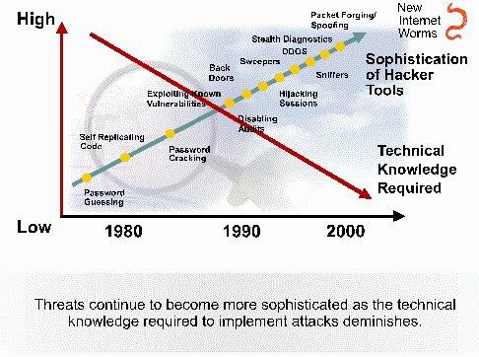
Attacks’ characteristic evolution

Slide 9
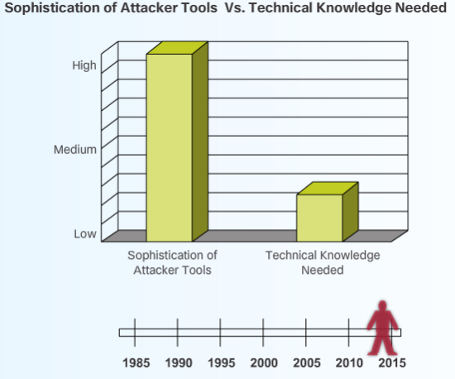
Evolution of the attacker tools in the last years
Notes:
Today, the Internet is a very different network compared to its beginnings. More people are relying on the network for their personal, financial and business needs. This information must be protected. However, attack tools are much more sophisticated, and highly automated, requiring less technical knowledge to use them than in the past.

Slide 10
Usernames and passwords
Normally, the system administrator will define a convention to establish usernames in a network (to access the OS).
Password rules are important, the control level will be accordingly with the necessary protection level.
A good security policy will contain the following:
- Passwords must expire after a specified time period.
- Passwords must contain letters, digits and special characters in order to not be easily broken.
The standard rule for passwords says that users must not write down the passwords on paper (or other support) and leave it with no supervision, or make it public.
- There must be defined rules concerning password expiry and account blocking (in the moment when an unsuccessful connection attempt was made).

Slide 11
Other standard security measures
Protection against viruses
Protection against spam
(example - http://policy.ucop.edu/doc/7000471/AntiSpam)

Slide 12
Evolution of Security Threats
“Necessity is the mother of invention.”
As network security became an integral part of everyday operations, devices dedicated to particular network security functions emerged.
One of the first network security tools was the intrusion detection system (IDS), first developed by SRI International in 1984.
An IDS provides real-time detection of certain types of attacks while they are in progress. This detection allows network security professionals to more quickly mitigate the negative impact of these attacks on network devices and users. In the late 1990s, the intrusion prevention system (IPS) began to replace the IDS solution. IPS devices enable the detection of malicious activity and have the ability to automatically block the attack in real-time.

Slide 13
Evolution of Security Threats
In addition to IDS and IPS solutions, firewalls were developed to prevent undesirable traffic from entering prescribed areas within a network, thereby providing perimeter security.
In 1988, Digital Equipment Corporation (DEC) created the first network firewall in the form of a packet filter.
These early firewalls inspected packets to see if they matched sets of predefined rules, with the option of forwarding or dropping the packets accordingly.
Packet filtering firewalls inspect each packet in isolation without examining whether a packet is part of an existing connection.

Slide 14
Evolution of Security Threats
In 1989, AT&T Bell Laboratories developed the first stateful firewall.
Like packet filtering firewalls, stateful firewalls use predefined rules for permitting or denying traffic.
Unlike packet filtering firewalls, stateful firewalls keep track of established connections and determine if a packet belongs to an existing flow of data, providing greater security and more rapid processing.

Slide 15
Virtual Private Network (VPN)
Link encryption can be used in the sense that users have the “illusion” they are in a private network even when they actually use a public network. This approach is called virtual private network - VPN.
A firewall represents a device (hardware or software) for access control between two networks or network segments. The firewall is filtering all the traffic between the internal network (more protected) and the external network which is less protected.
The data transmission mode in a VPN is called encrypted communication channel or, for short, tunnel.

Slide 16
VPN Basic architecture

Slide 17
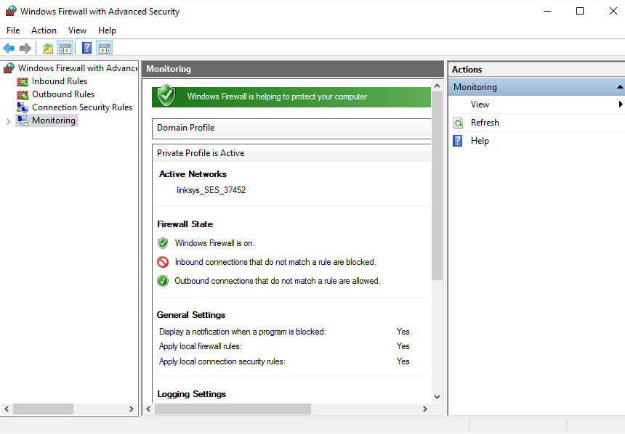
Windows 10 firewall

Slide 18
Linux firewalls
There are several firewalls we may install on Linux. The most well-known firewall is IPtables. Several characteristics are implemented.
Some of the features of IPtables:
It lists the contents of the packet filter ruleset.
It’s lightning fast because it inspects only the packet headers.
You can Add/Remove/Modify rules according to your needs in the packet filter rulesets.
Supports Backup and restoration with files.
IPcop is another Linux firewall, for home and SOHO users. More details at: http://www.ipcop.org/

Slide 19
Conclusions
The OS security represents an important part of the network security. When we must implement the OS security we must take into consideration the following:
Defining an acceptable security policy for the company’s network; here is defined what is permitted and what is not permitted in the company’s network.
The security policies regarding passwords must be enforced and respected, including an expiration date, blocking rules and using a combination of letters, digits and special characters, imposing a minimum length for these.

Slide 20
Conclusions
The security threats form the Internet are including hackers, crackers, viruses and worms. Although a hacker can produce damage, by definition a cracker is the one who enters a system to produce a damage or to steal information.
A virus or a worm can also create substantial damages. A worm is not attaching to files but remains active in memory auto-replicating.
Good security policies help minimizing threats. The employees and trust users have access to critical information about the network (including passwords) and can facilitate commercial espionage.

Slide 21
Conclusions (2)
System administrators must protect the computers against data theft and destruction and “denial of service” attacks. Moreover, the “Distributed Denial of Service (DDoS)” attacks, originating from multiple sources, can be extremely difficult to counter attack.
In order to keep the OS updated, the security patches and upgrades must be installed permanently as soon as they are available.
An Internet firewall represents a good protection against the exterior attacks.
Other important security instruments are the VPNs, IPSs (IPS - Intrusion Prevention System) that can be used in combination with a firewall solution.

